Slide 1
UNIT – I
Introduction: Basic concept of simple control system – open loop – closed loopcontrol systems. Effect of feedback on overall gain – stability sensitivity and external noise.
Types of feedback control systems – Liner time invariant, time variant systems and nonlinear control systems
Mathematical models and Transfer functions of Physical systems: Differentialequations – impulse response and transfer functions – translational and rotational mechanical systems. Transfer functions and open loop and closed loop systems. Block diagram representation of control systems – block diagram algebra – signal flow graph – Mason’s gain formula
Components of control systems: DC servo motor – AC servo motor – synchrotransmitter & receiver

Slide 2
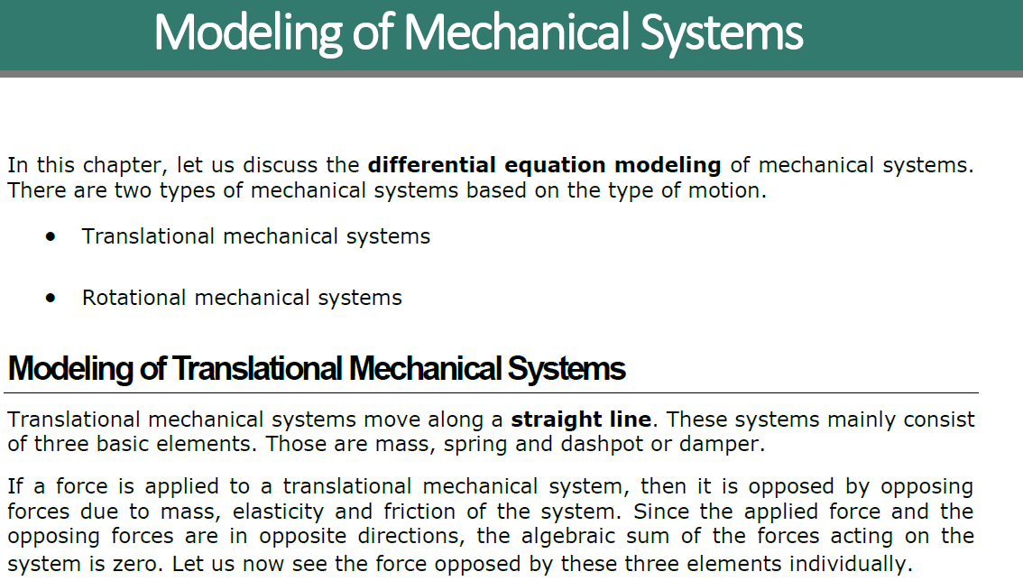

Slide 3
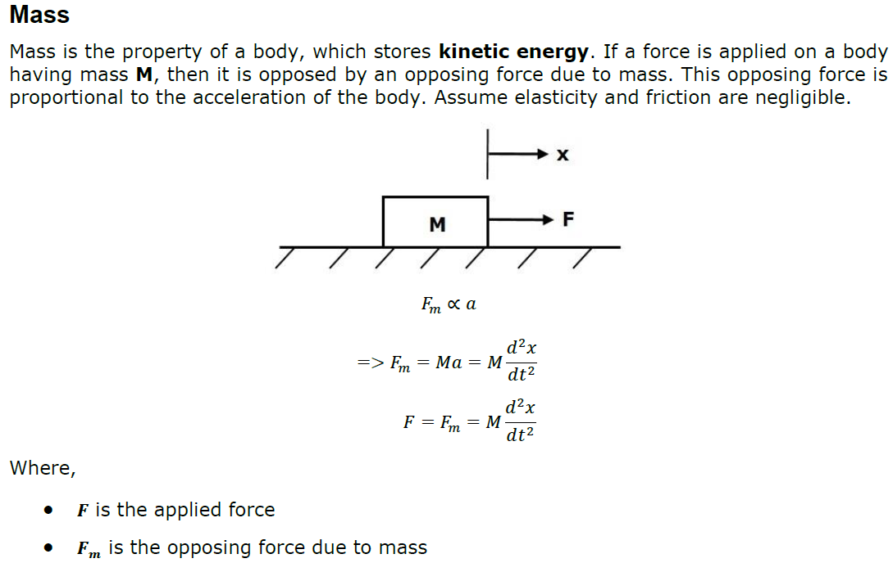
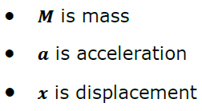

Slide 4
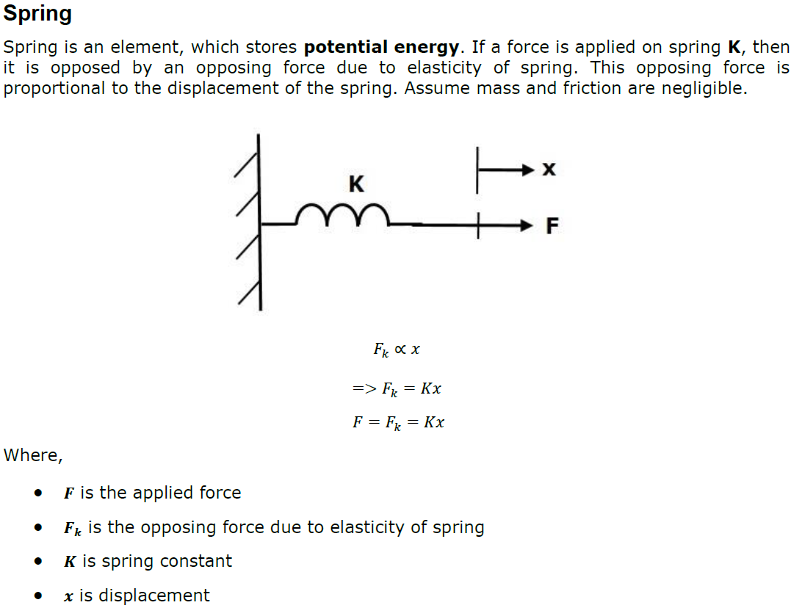

Slide 5

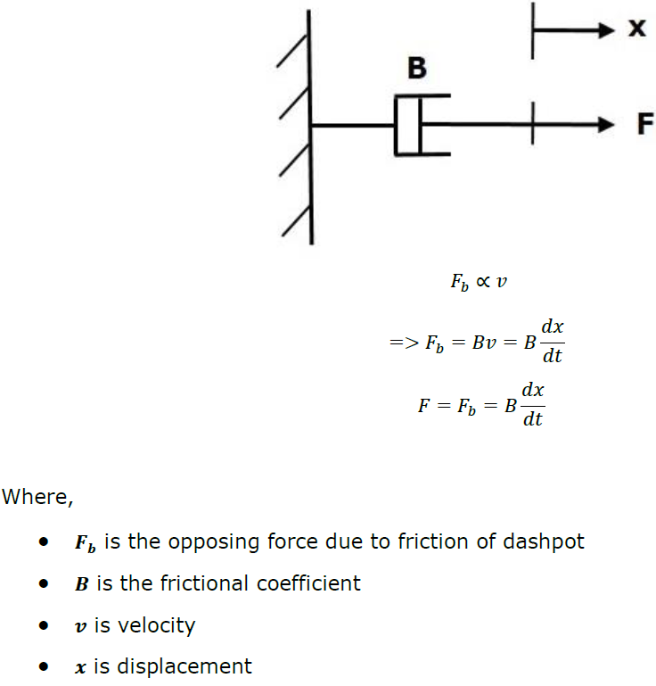

Slide 6


Slide 7

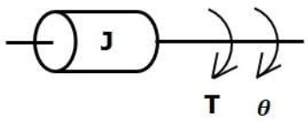
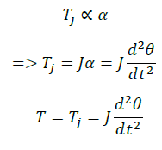

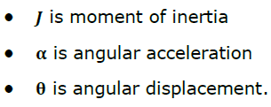

Slide 8

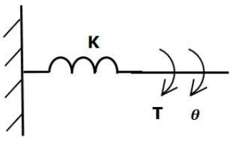
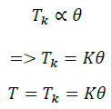


Slide 9

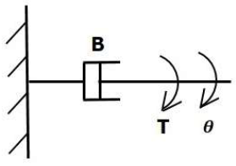
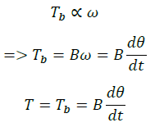


Slide 10
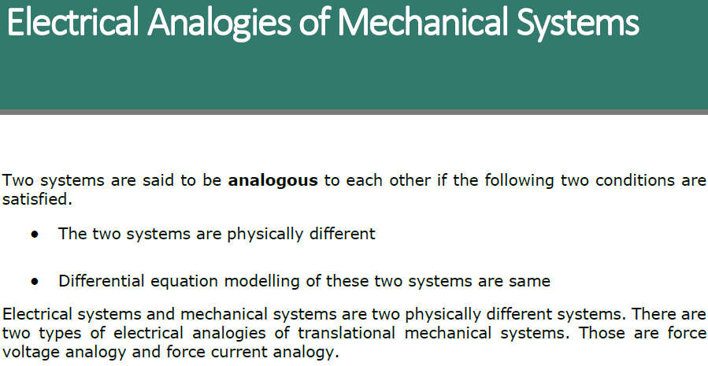

Slide 11
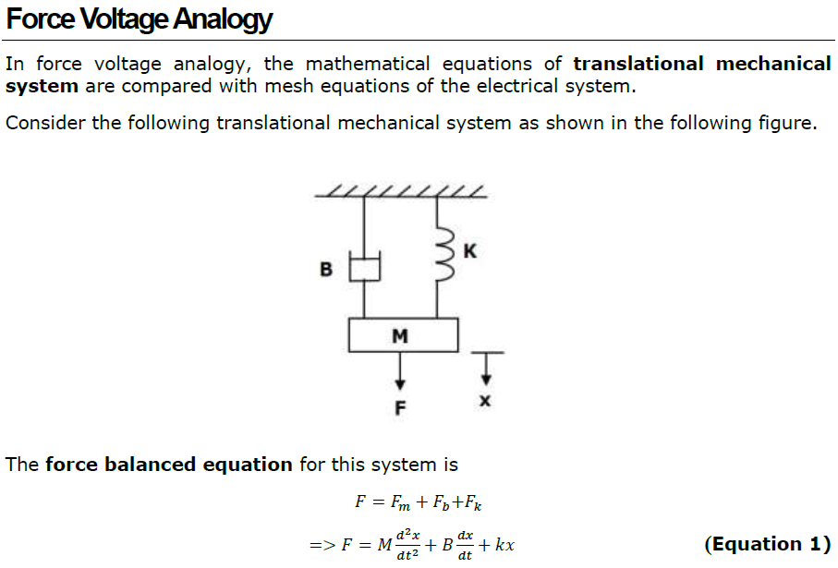

Slide 12

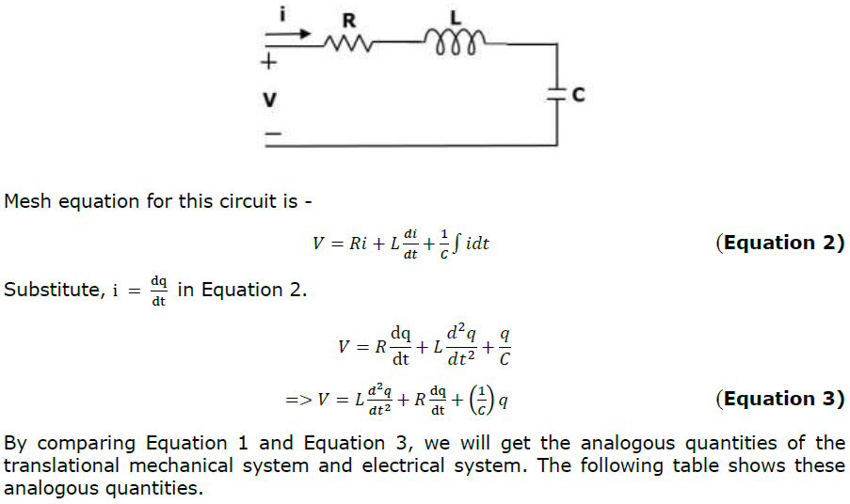

Slide 13
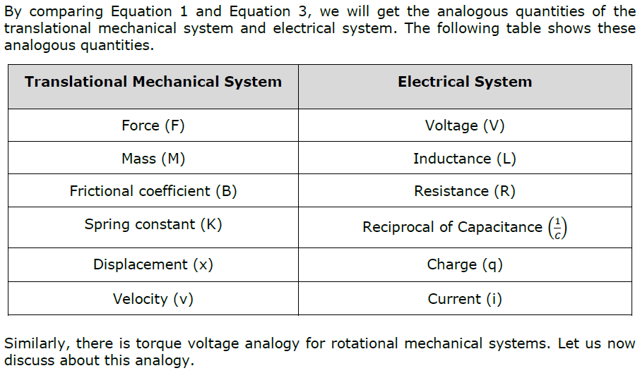

Slide 14



Slide 15
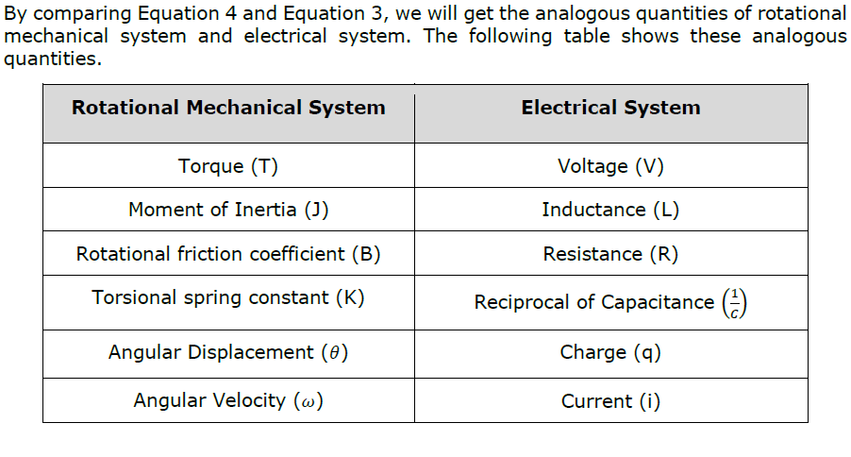

Slide 16
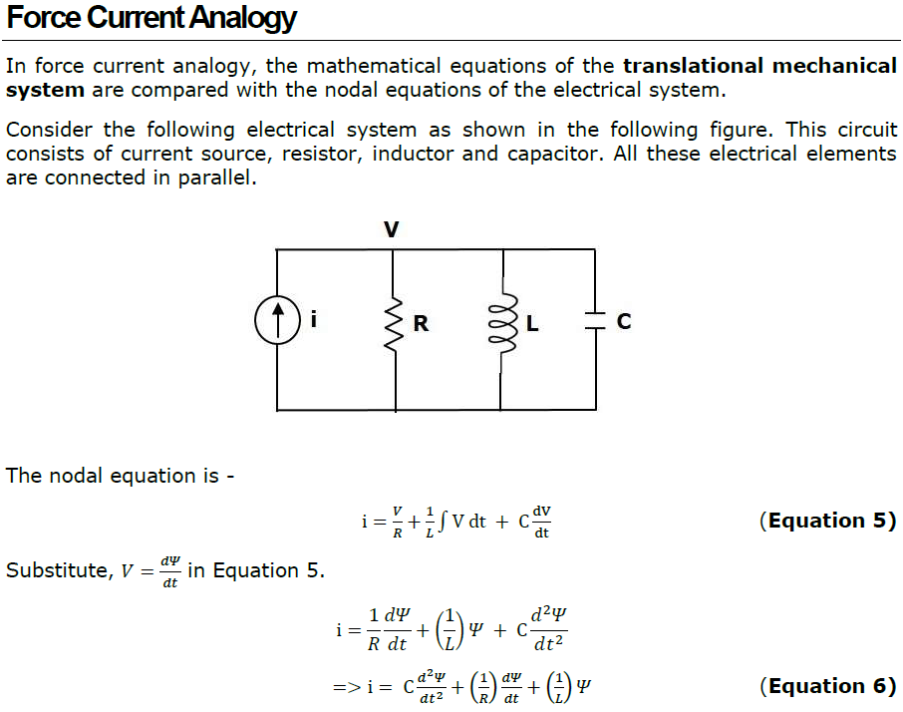

Slide 17
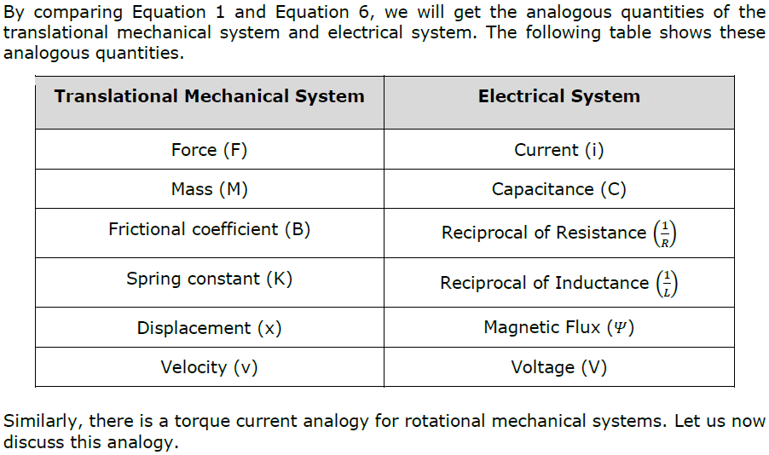

Slide 18
